Slide 1
Sprint 1
Music Trivia Web-based Game

Slide 2
Contents
What I did?
What’s next?

Slide 3
What I did?
Project plan
Event storming
User story
Architecture diagram
Research plan

Slide 4
User story
User story 1: As a player, I want to select the genre of music and the year that I want to play, so that I can test my knowledge on that specific music.
User story 2: As a player, I want to have the option to choose how many rounds the session has, so that we can play longer or shorter rounds.

Slide 5
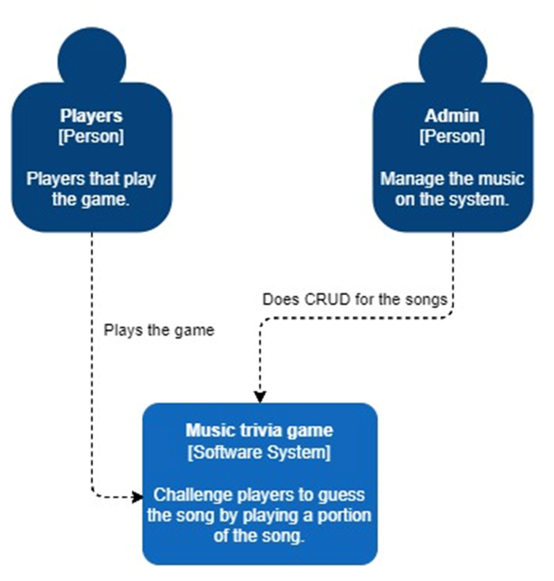
C1

Slide 6
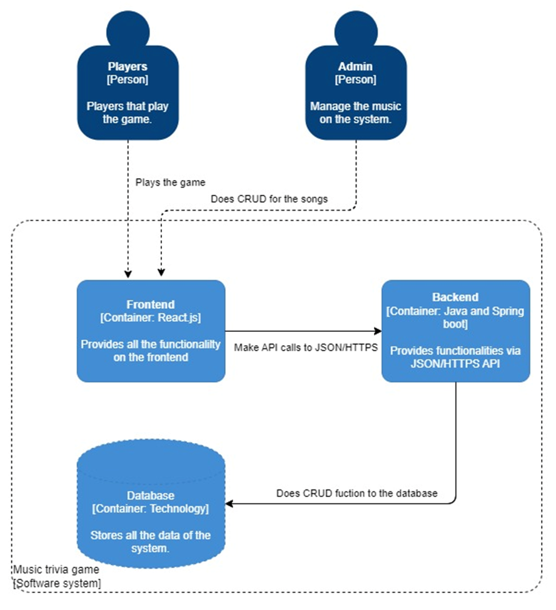
C2

Slide 7
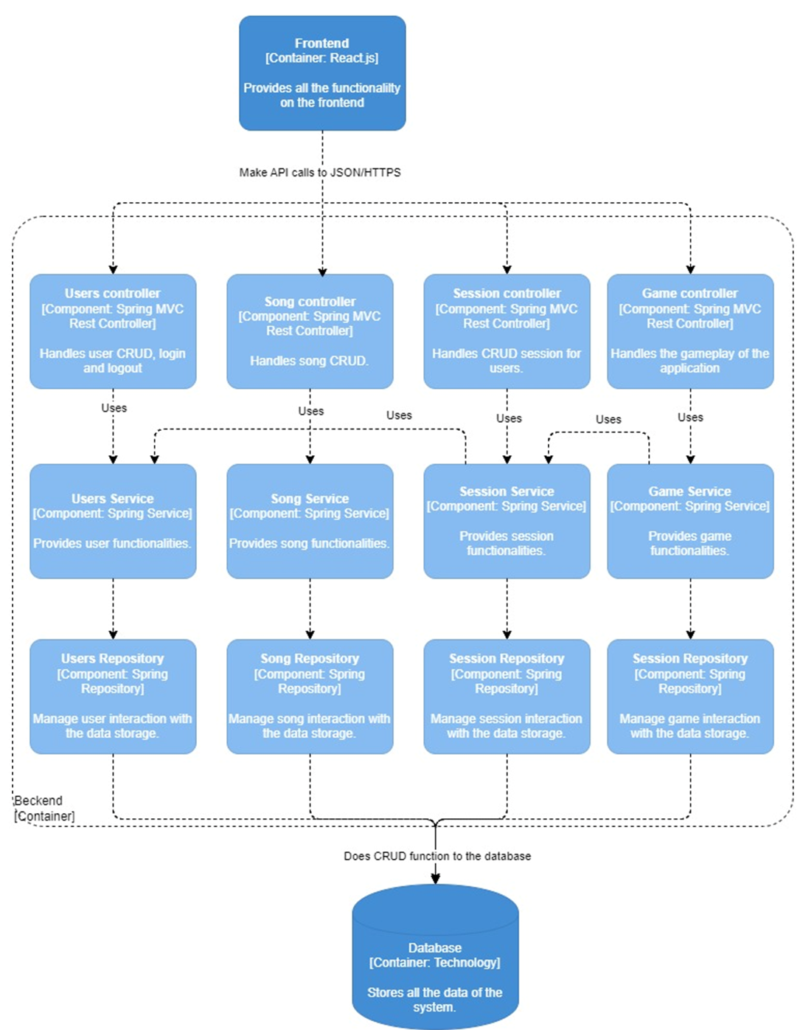
C3

Slide 8
Research questions
Main question: What kind of storage solution fits for storing and using large files in a music trivia web-based game?
Sub-questions:
Which databases should be considered for a comparison test?
Which of the chosen databases is easy to implement on the web?
What is the storage size of the chosen databases for the free version?
Among the chosen databases, which one offers greater scalability for free?
How does the performance of the chosen databases compare?

Slide 9
What’s next
Setup the initial project environment.
Add some functional requirement.
Do research question 1.

Slide 10
What’s next
Setup initial environment.
Create wireframe.
Do some functional requirements.
Do research question 1.

Slide 11

Thank you

